Slide 1
DAV UNIVERSITY DEPARTMENT OF COMPUTER SCIENCE AND ENGINEERING
DAVU
COURSE NAME :OOAD
COURSE CODE: CSE429

Slide 2
TIMING DIAGRAM

Slide 3
INTRODUCTION
UML timing diagrams are used to display the change in state or value of one or more elements over time.
timeline
It can also show
the interaction between timed events
the time and duration constraints that govern them.
State 1
State 2
t1
t2

Slide 4
ELEMENTS OF TIMING DIAGRAM
State Lifeline
Value Lifeline

Slide 5
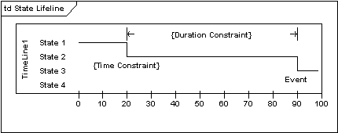
State Lifeline
A state lifeline shows the change of state of an item over time. The X-axis displays elapsed time in whatever units are chosen, while the Y-axis is labelled with a given list of states. A state lifeline is shown below.

Slide 6
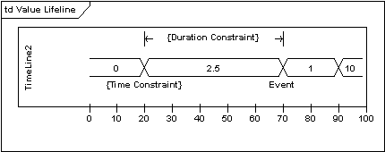
Value Lifeline
A value lifeline shows the change of value of an item over time. The X-axis displays elapsed time in whatever units are chosen, the same as for the state lifeline. The value is shown between the pair of horizontal lines which cross over at each change in value. A value lifeline is shown below.

Slide 7
State and value Lifelines Together
State and value Lifelines can be stacked one on top of another in any combination. They must have the same X-axis. Messages can be passed from one lifeline to another. Each state or value transition can have a defined event, a time constraint which indicates when an event must occur, and a duration constraint which indicates how long a state or value must be in effect for. Once these have all been applied, a timing diagram may look like the following.

Slide 8
Example : Timing Diagram

Slide 9
THANKS

